Slide 1

YAT
Yet Another Terminal
An open source software project by Matthias Kläy

Slide 2
Agenda
Existing Terminals
YAT
YAT History
YAT Development
YAT Demo
YAT Home

Slide 3
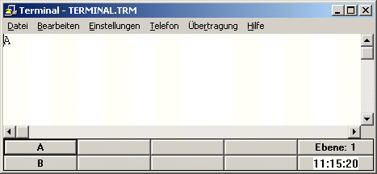
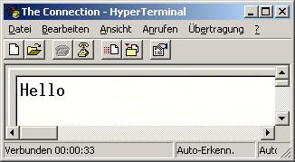
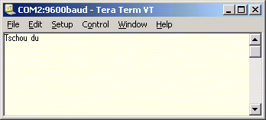
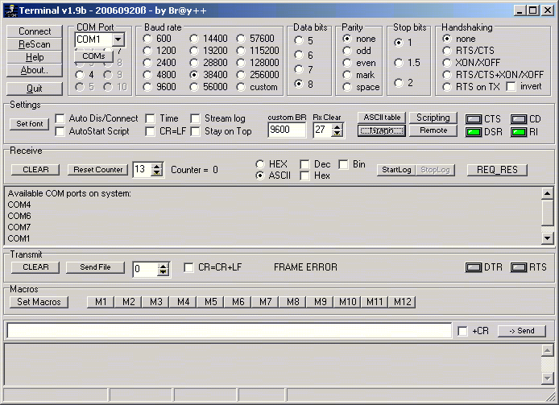
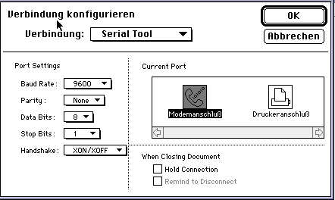

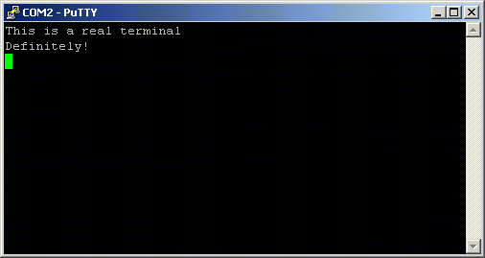
Existing Terminals
Original Win 3.11 terminal
 Predefined keys
❒ Limited to COM1..4
❒ Limited to 19200 baud
❒ Complex settings dialogs
Win 95 HyperTerminal
 COM1..256 / TCP
❒ No predefined keys
❒ Limited features
Tera Term
 Continued development
 SSH/UTF-8/… support
❒ Win16 subsystem
Br@y++ Terminal
 Scripting (experimental)
❒ No TCP support
❒ Cramped user interface
Good ol’ VersaTerm
 Very comprehensive
❒ Available for Mac only
PuTTY & Co.
 Highly optimized for
Telnet/SSH/…
❒ Not really useful for
straight forward serial
device communication

Slide 4
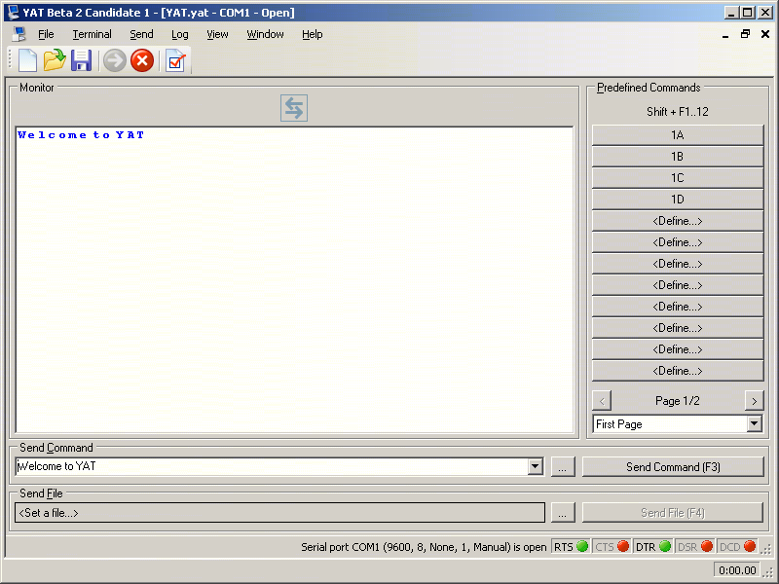
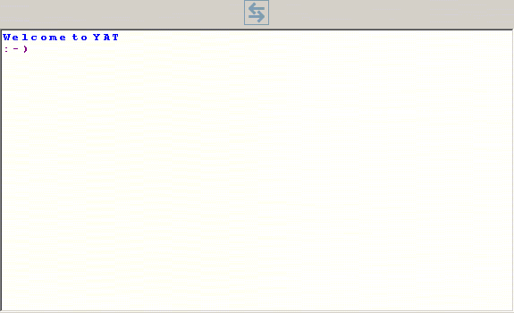
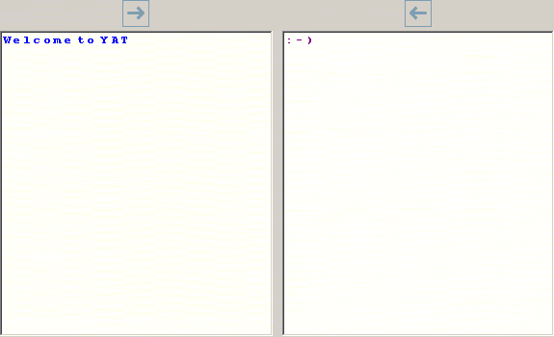
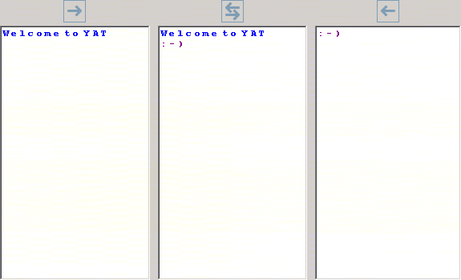
YAT
 Menu and toolbar
 File and terminal status
 Unlimited number
of predefined keys
 Bidirectional monitor
 Rx only monitor
 Tx only monitor
 String/Char
 Hex/Dec/Oct/Bin
 Timestamp
 Length
 Send command
 Multi-line command
 Contol line status
 Send file
 Terminal status
 Stopwatch

Slide 5

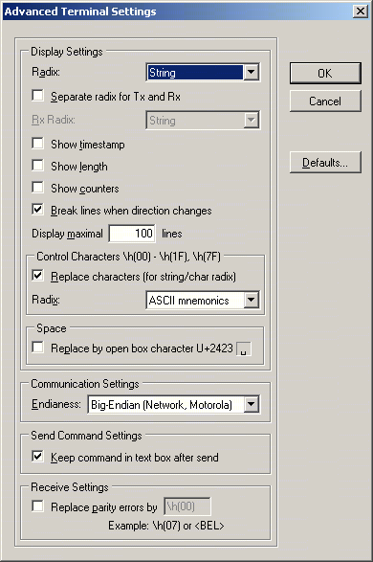
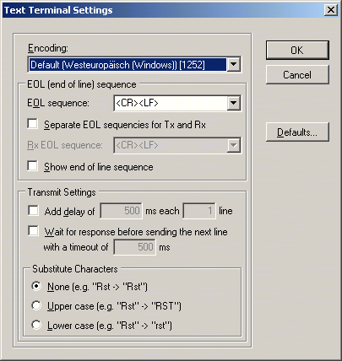
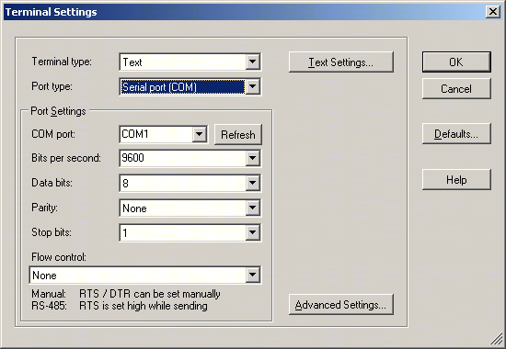
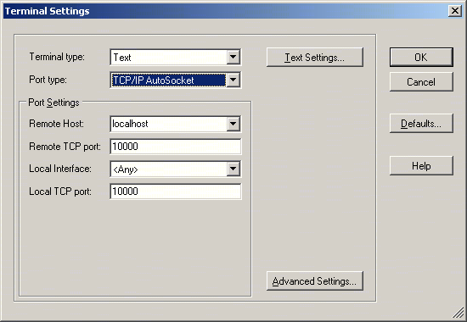
Terminal Settings
.yat
 Text or Binary
Settings
 Text or Binary
 Serial Port (COM)
 Virtual Ports (USB/Bluetooth/…)
 COM1…COM256…COMnnnnn
 Any baud rate
 TCP/IP Client
 TCP/IP Server
 TCP/IP AutoSocket
 UDP/IP Socket
 Advanced Settings

Slide 6
Parser Format
Default "OK"
Binary
Octal
Decimal
Hexadecimal
Character
String "\s(OK)"
ASCII controls (0x00..0x1F, 0x7F) "<CR><LF>"
"\b(01001111)\b(01001011)"
"\o(117)\o(113)"
"\d(79)\d(75)"
"\h(4F)\h(4B)"
"\c(O)\c(K)"
"\b(01001111 01001011)"
"\o(117 113)"
"\d(79 75)"
"\h(4F 4B)"
"\c(O K)"

Slide 7
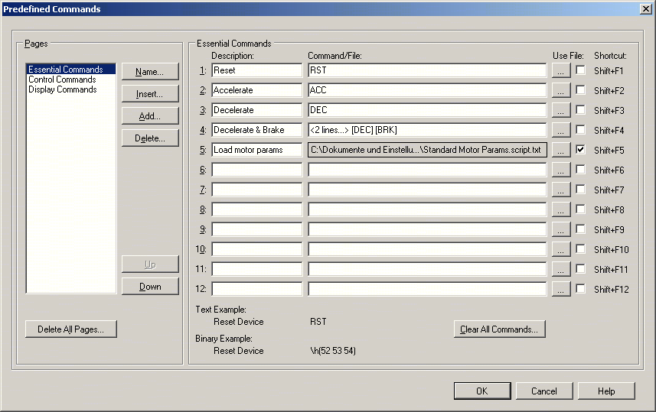
Predefined Keys
 Description
 Shortcut
 Multi-line
 Any number
of pages
 File

Slide 8

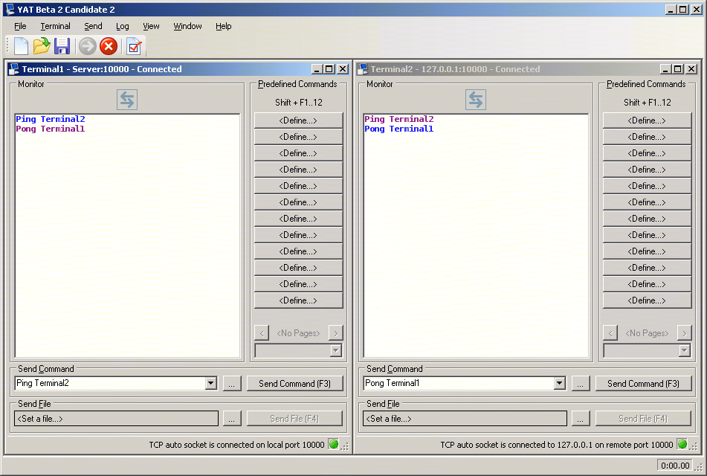
Workspace Settings
.yaw

Slide 9
YAT History
HSR Hochschule für Technik Rapperswil
KTI/CTI project “BBP - Balance Based Pipetting” between HSR and Mettler-Toledo
XTerm232 1.0
  2003-08..10
WK
WK
SourceForge
WK
YAT 2.0
  2006 2007 2008
Alpha 1..3
Beta 1
Beta 2
Beta 3

Slide 10
YAT Development
Framework
  .NET 2.0
Programming
  C#
  Visual Studio 2005
Libraries
  ALAZ socket extension
Testing
  NUnit
  Manual
Build
  Visual Studio 2005
  Batch Build
Installer
  Visual Studio 2005
  Standard Installer

Slide 11
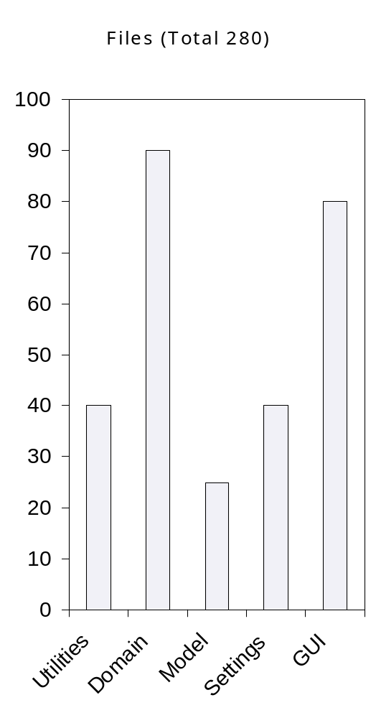
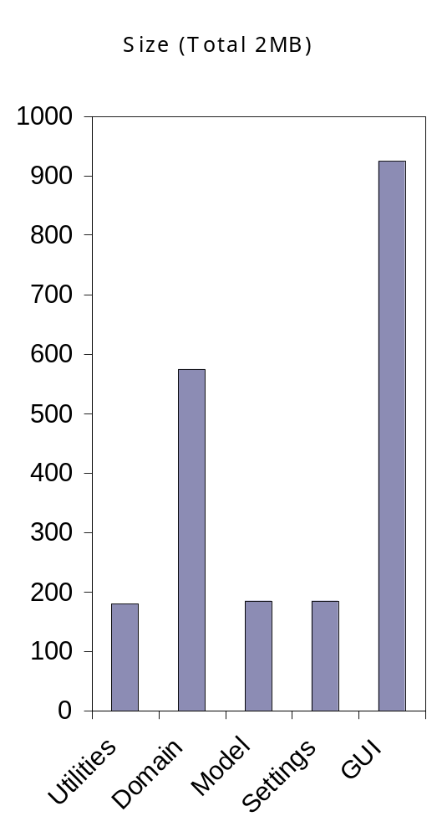
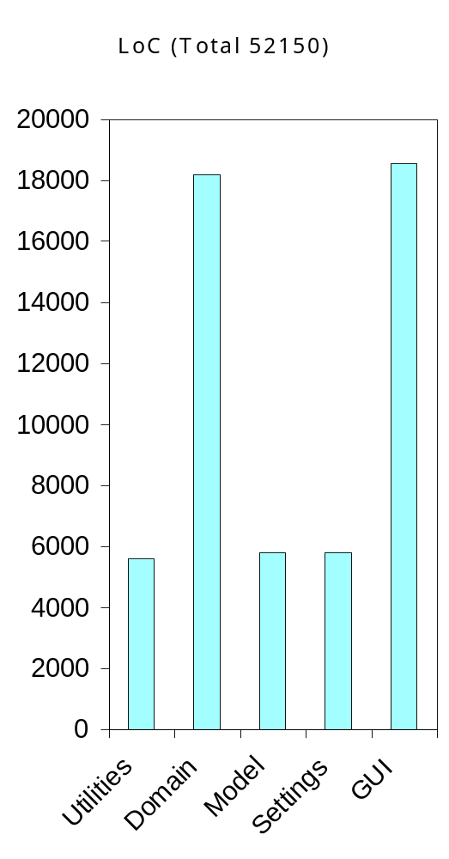
YAT Source Code
Notes:
Utilities.XEnum: 520 LoC @ 17 kB = 33.5 CpL
Domain.Terminal: 870 LoC @ 26 kB = 30.5 CpL
Model.Terminal: 1540 LoC @ 43 kB = 30 CpL
32 CpL
Gui.Terminal.Designer: 1950 LoC @ 132 kB = 70 CpL
=> Gui.Designer @ 550 kB = 7850 LoC
Gui.Terminal: 2480 LoC @ 84 kB = 35 CpL
=> Gui @ 375 kB = 10970 LoC
Total: 33600 + 7850 + 10700 = 52150 LoC

Slide 12
YAT Demo
Notes:
Show first start
Define some keys
Send something
Close YAT
Start again → everything restored
Show timestamp/length
Show connect time
Show counters
Show stopwatch
Show format
Show space replacement

Slide 13
YAT Home
SourceForge
  http://sourceforge.net/projects/y-a-terminal/
  Source code repository (Subversion)
  Mailing list
  Releases
  Support request tracker
  Feature request tracker
  Bug tracker

Slide 14
Sign up for YAT
max.muster@mymail.com

Slide 15
Q&A

Slide 16
Thanks

